Slide 1

Brane Template Builder

Slide 2
Overview:
Brane Template Builder is an open source content management system(CMS) written in PHP and based on the Symfony web application framework.​
We can simplifies the process of creating responsive websites and HTML templates
Brane Template Builder is a powerful visual web design tool.​
Brane Builder provides a user-friendly interface for web designers.​
Markdown methodology is followed in content creation

Slide 3
Objective:
Websites
Invoice templates
Mail templates
Report Templates
Content management
Responsive Methods

Slide 4
Feature List:
Header.
Footer
Nav Bar
Progress Bar
Embed Videos
Chat bot
Social Icon
Gallery
Template Creation
Multimedia control
Form controls
Input Group
Paragraph
Button Group
Button Toolbar
Table

Slide 5
Technology and its version:
Open source framework: Grave CMS v1.7
Back-end:
PHP v7.3.6 to 8.0
PHP Symfony v1.23
PHP Symfony Twig V1.44
Guzzlehttp v1.7
Doctrine/cache v1.10
Front-end:
HTML v5
Jquery/Ajax v3.7.1
CSS v4
Boostrap v5
Web.js v1.23.0

Slide 6
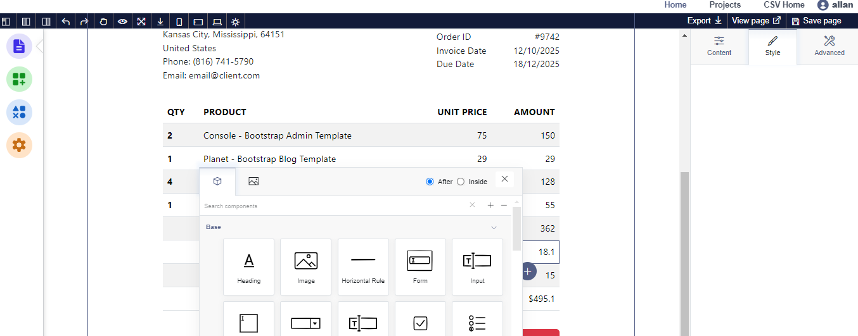
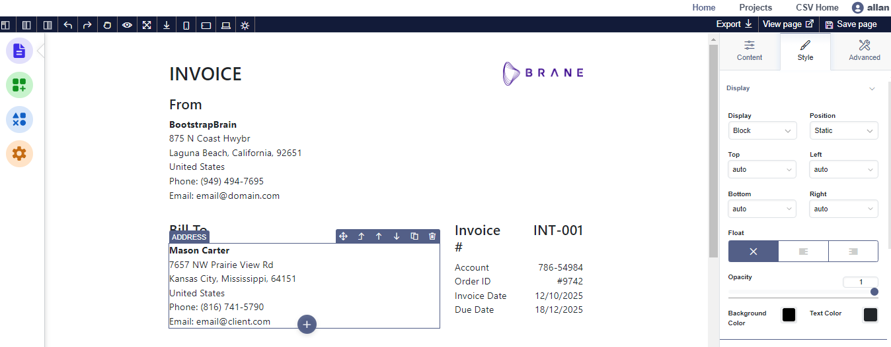

Slide 7
Demo Link:
project_demo_complete 1.mp4

Slide 8
Thank You

